Slide 1


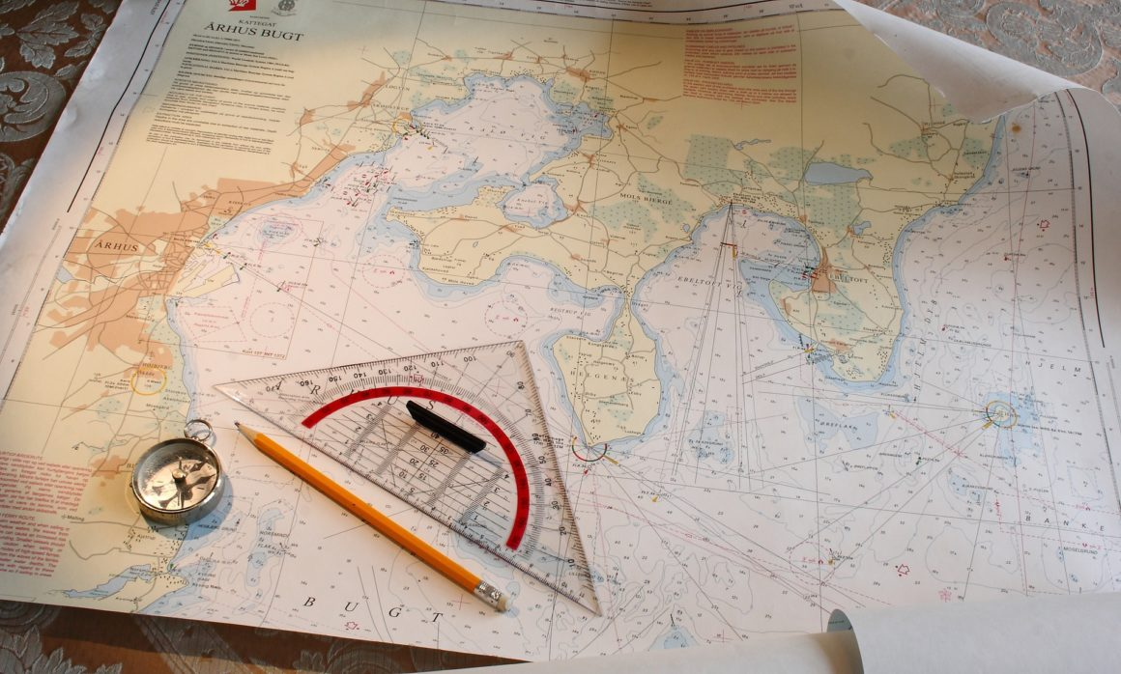
Chart Preparation
NN220-05
SEANAV I United States Naval Academy
NN220 – Fundamentals of Navigation– Updated May 2023
Operations Officer I HMS PROTECTOR A173 I The Ice Patrol Ship

Slide 2
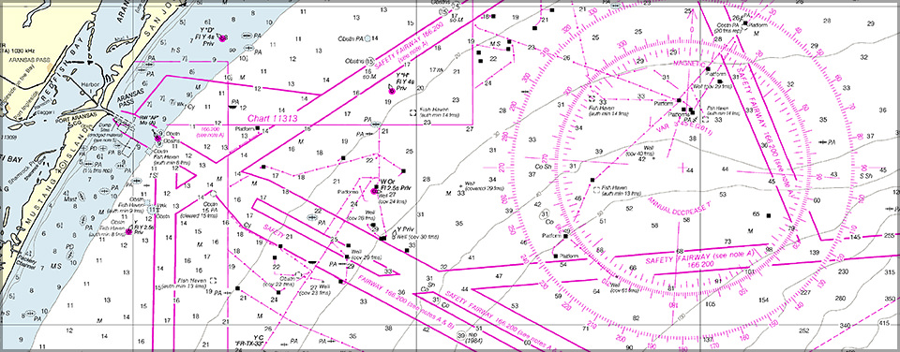
References
-The American Practical Navigator, Pub. No. 9, Bowditch, VOL. 1, 2019 Edition -Surface Ship Navigation Department Organizations and Regulations Manual (NAVDORM), COMNAVSURFPAC/COMNAVAIRPAC/COMNAVAIRLANT/COMNAVSURFLANT INSTRUCTION 3530.4 series -Chart Preparation Checklist
SEANAV I United States Naval Academy
NN220 – Fundamentals of Navigation
Operations Officer I HMS PROTECTOR A173 I The Ice Patrol Ship

Slide 3
Enabling Objectives
FIND corrections for a given chart. APPLY corrections to a chart. IDENTIFY information that must be highlighted or outlined on a chart in accordance with the checklist. PLOT a track line using given waypoints. GENERATE track box labels. PLOT NAVAIDs using appropriate shapes and labels. GENERATE a command review box.
SEANAV I United States Naval Academy
NN220 – Fundamentals of Navigation
Operations Officer I HMS PROTECTOR A173 I The Ice Patrol Ship

Slide 4
Applicability
-The CNO-directed transition from paper standard nautical charts (SNC) to the use of electronic charts continues to move forward and by 2023, NOAA will systematically cancel production of paper charts. -The fundamentals developed by preparing and navigating on paper charts, however, is invaluable to the prospective mariner. -The Department of Seamanship and Navigation, in concurrence with USNA leadership, has determined that we must continue to teach the future officers of the fleet how to do this. -SWO is not the only community to work with nautical charts: Marines Aviators SUBS SPECWAR INTEL
SEANAV I United States Naval Academy
NN220 – Fundamentals of Navigation
Operations Officer I HMS PROTECTOR A173 I The Ice Patrol Ship

Slide 5
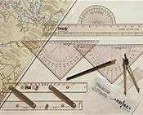
NAVKIT
-Ensure that you have the following instruments: Dividers Compasses Pencils and Erasers (A mechanical pencil is preferred due to the fine edge) Nautical Slide Rule (For quick and easy time, speed and distance calculations) Markers (Green, Yellow, Blue) Fine Edge Black Marker NAVAID Template Chart Correction Template All items should be available in your NAVKIT.
SEANAV I United States Naval Academy
NN220 – Fundamentals of Navigation
Operations Officer I HMS PROTECTOR A173 I The Ice Patrol Ship

Slide 6
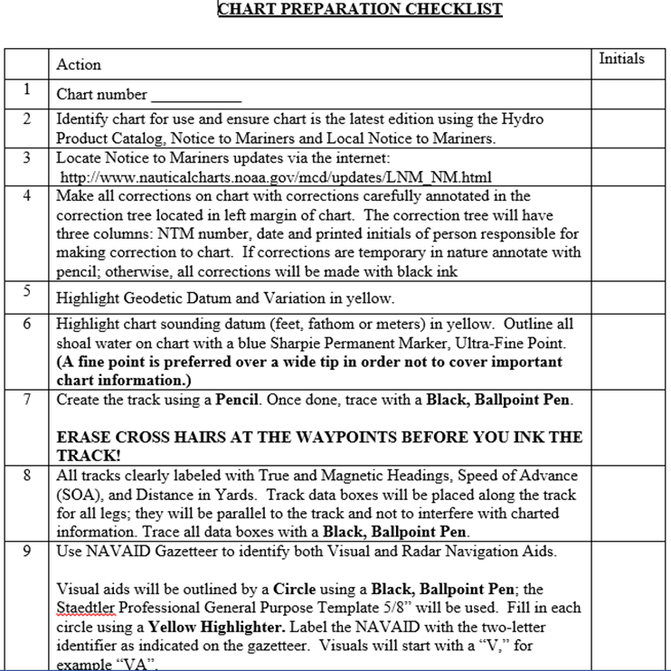
Chart Preparation Checklist
Every ship that still uses SNC’s as a primary plot has a command specific checklist encompassing the requirements from NAVDORM.
Initial only when action is complete or write “N/A”.
SEANAV I United States Naval Academy
NN220 – Fundamentals of Navigation
Operations Officer I HMS PROTECTOR A173 I The Ice Patrol Ship

Slide 7
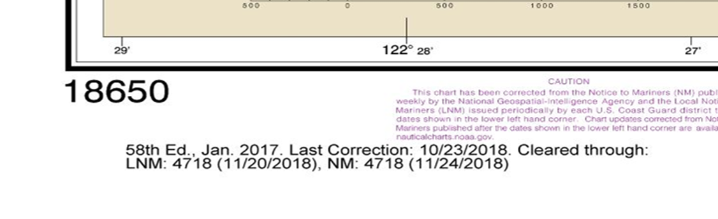

Verify the Latest Edition
http://www.charts.noaa.gov/MCD/Dole.shtml
SEANAV I United States Naval Academy
NN220 – Fundamentals of Navigation
Operations Officer I HMS PROTECTOR A173 I The Ice Patrol Ship

Slide 8
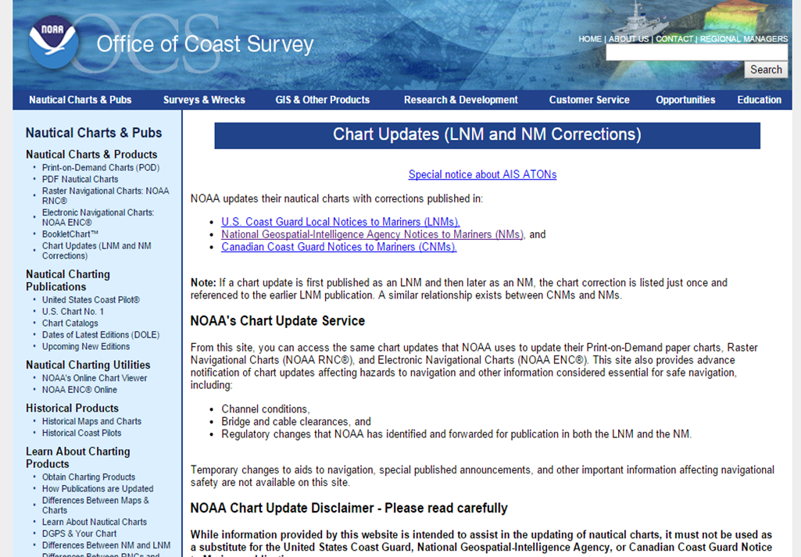
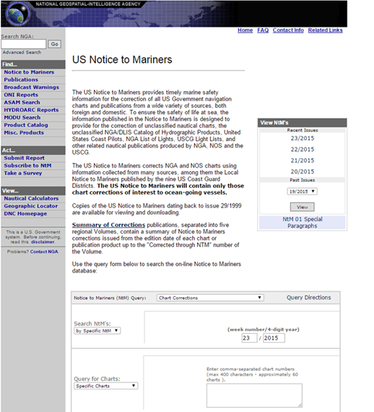
Check Notice To Mariners
https://msi.nga.mil/NGAPortal/MSI.portal?_nfpb=true&_st=&_pageLabel=msi_portal_page_61
SEANAV I United States Naval Academy
NN220 – Fundamentals of Navigation
Operations Officer I HMS PROTECTOR A173 I The Ice Patrol Ship

Slide 9
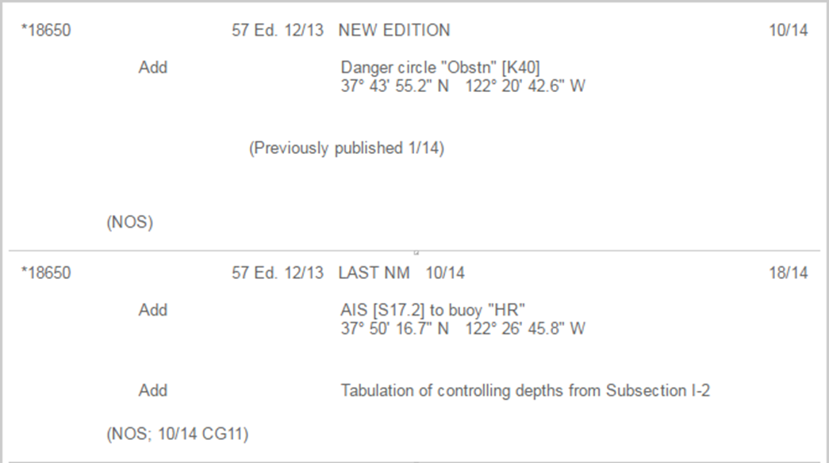

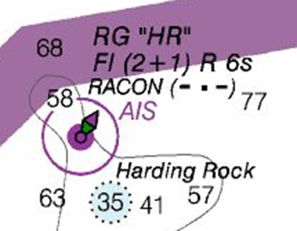
Example of Chart Corrections
Chart One Chapter + Line
SEANAV I United States Naval Academy
NN220 – Fundamentals of Navigation
Operations Officer I HMS PROTECTOR A173 I The Ice Patrol Ship

Slide 10

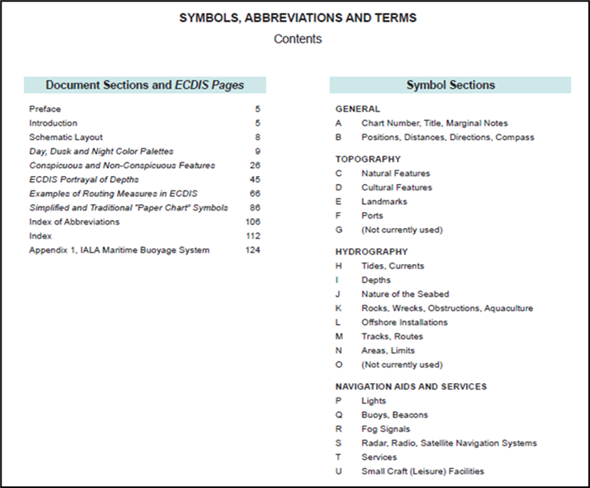
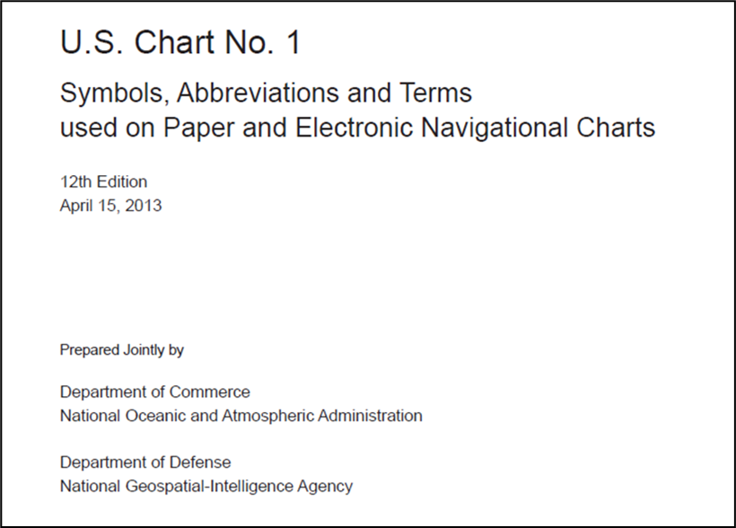
Chart No. 1
- United States of America Nautical Symbols Abbreviations and Terms.
SEANAV I United States Naval Academy
NN220 – Fundamentals of Navigation
Operations Officer I HMS PROTECTOR A173 I The Ice Patrol Ship

Slide 11
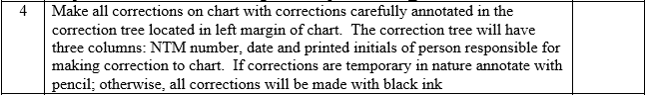
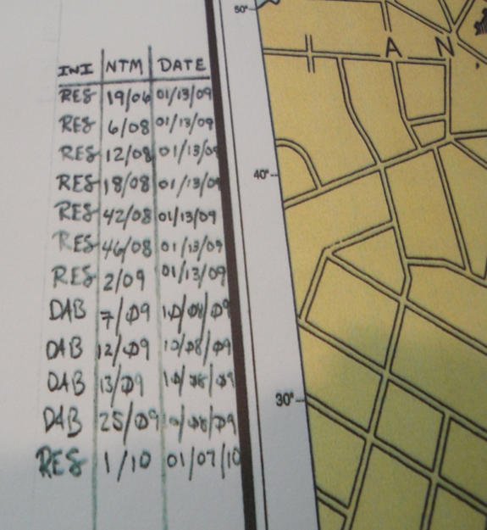
Chart Corrections
A good rule of thumb is to do the latest correction first and work backwards as that gets rid of the need to correct the same thing on two different occasions.
First, locate the position on the chart. Add correction in pencil first; Pen the correction after verified correct.
If deleting information use WHITEOUT to erase the old information. (DO NOT SCRATCH OUT OR USE PENCIL OR PEN TO COVER IT UP!)
SEANAV I United States Naval Academy
NN220 – Fundamentals of Navigation
Operations Officer I HMS PROTECTOR A173 I The Ice Patrol Ship

Slide 12
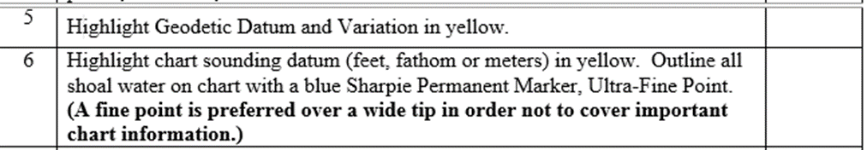
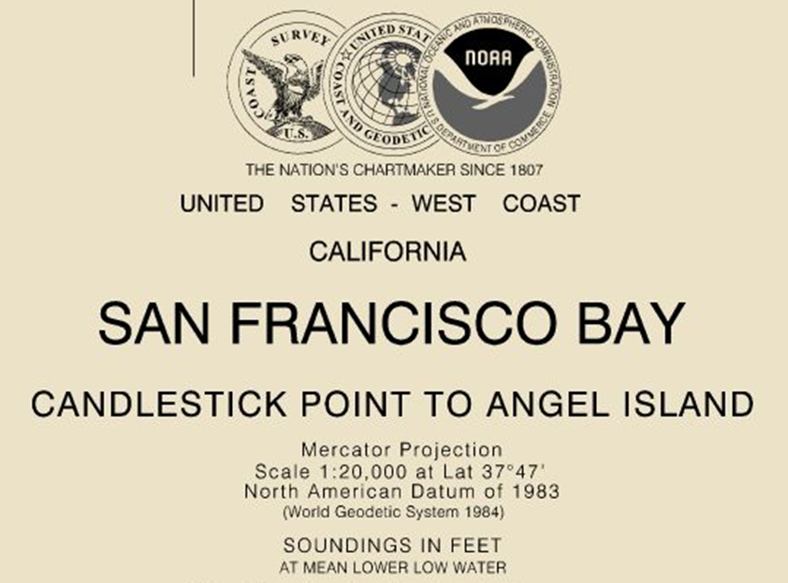
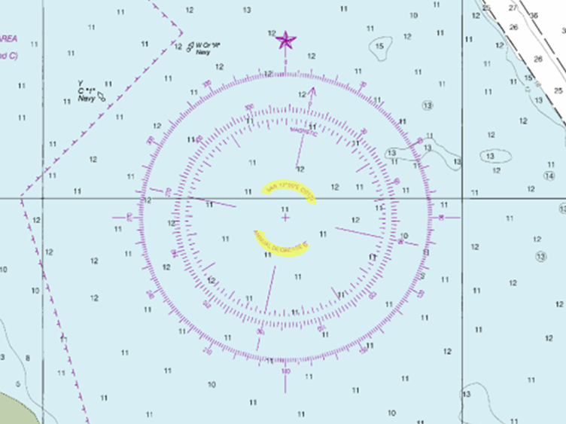
Highlight Datum and Variation
Don’t forget the soundings listed on the top and bottom of the chart!!!!
SEANAV I United States Naval Academy
NN220 – Fundamentals of Navigation
Operations Officer I HMS PROTECTOR A173 I The Ice Patrol Ship

Slide 13
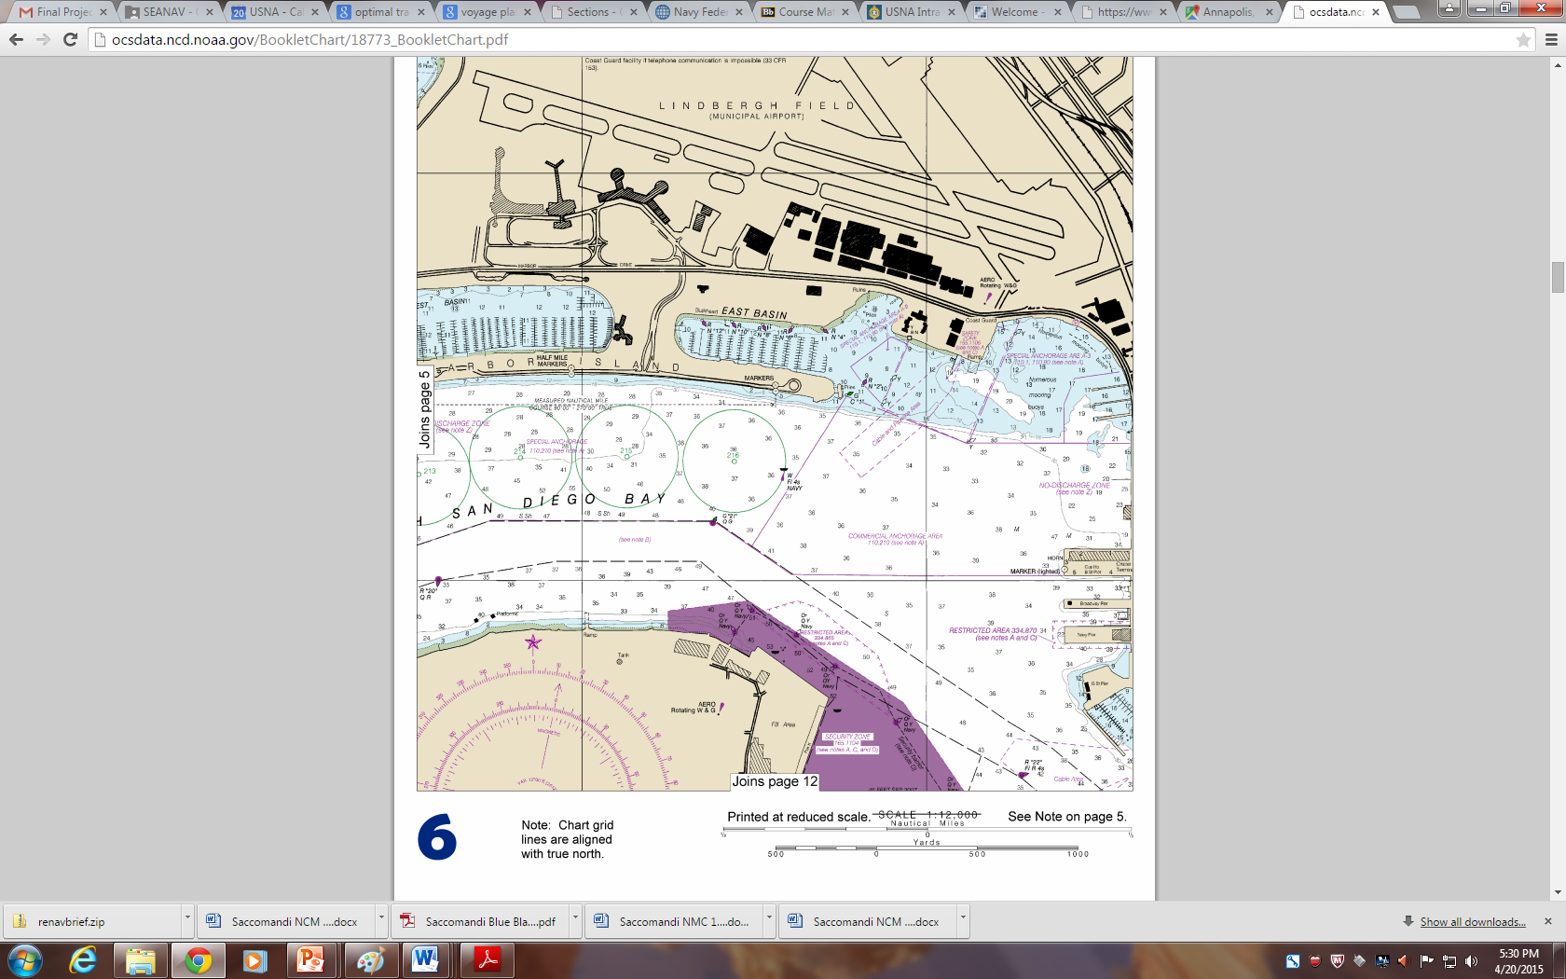

50

Slide 14
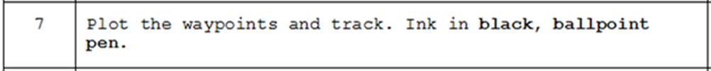
Plot the Track
First plot the waypoints and track lines in pencil. Once verified correct ink with black, ballpoint pen.
Use SLIDE RULER to connect waypoints.
Once connected, slide the ruler over to the nearest compass rose or line of meridian to determine the TRUE COURSE.
Ensure you are reading the True Bearing in the direction your course line is going.
SEANAV I United States Naval Academy
NN220 – Fundamentals of Navigation
Operations Officer I HMS PROTECTOR A173 I The Ice Patrol Ship

Slide 15
50

Slide 16
90
270
124°T / 112°M
3,200 yds
6 kts
124
304
50
090°T / 078°M
1,200 yds
6 kts

Slide 17
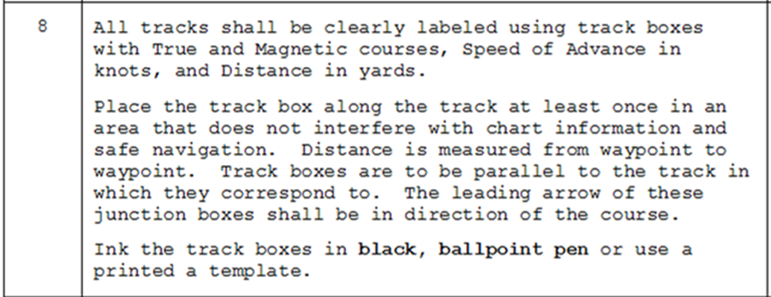
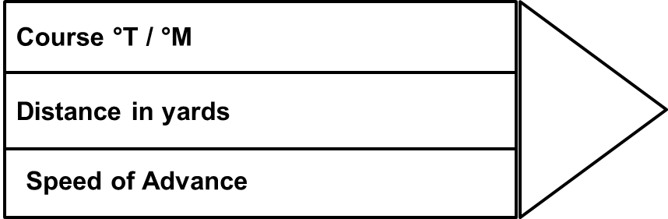
Track Boxes
SEANAV I United States Naval Academy
NN220 – Fundamentals of Navigation
Operations Officer I HMS PROTECTOR A173 I The Ice Patrol Ship

Slide 18
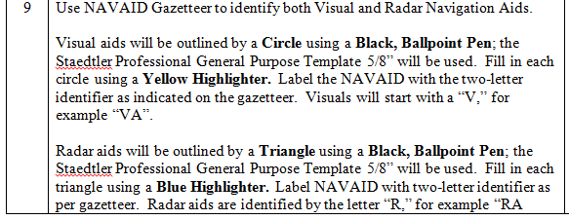

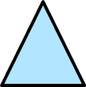

Navigation Aids (NAVAIDs)
SEANAV I United States Naval Academy
NN220 – Fundamentals of Navigation
Operations Officer I HMS PROTECTOR A173 I The Ice Patrol Ship

Slide 19
Visual Aids
Something you can SEE, and will stand out (you don’t want to make the bearing taker’s job hard):
A Dome
A FIXED aid to navigation (buoys move!)
Best for navigation ON THE BEAM
Shows change in bearing quicker
SEANAV I United States Naval Academy
NN220 – Fundamentals of Navigation
Operations Officer I HMS PROTECTOR A173 I The Ice Patrol Ship

Slide 20
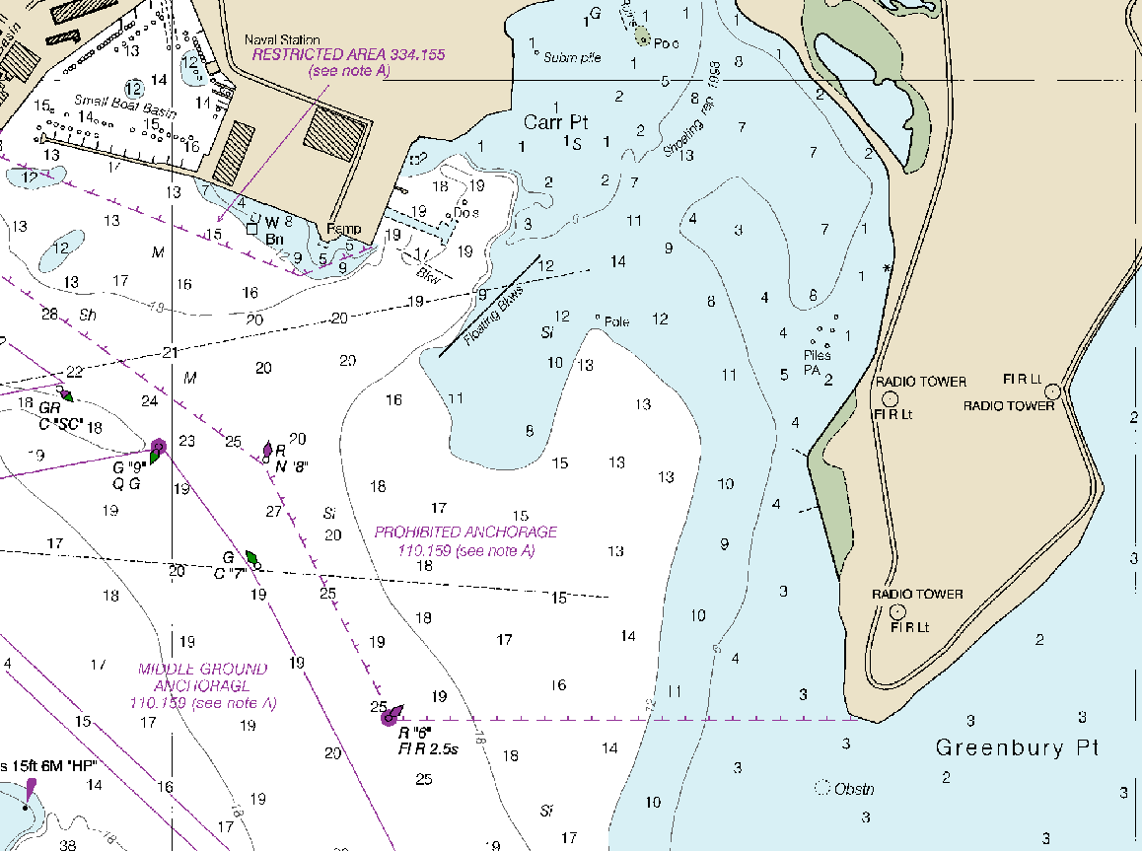
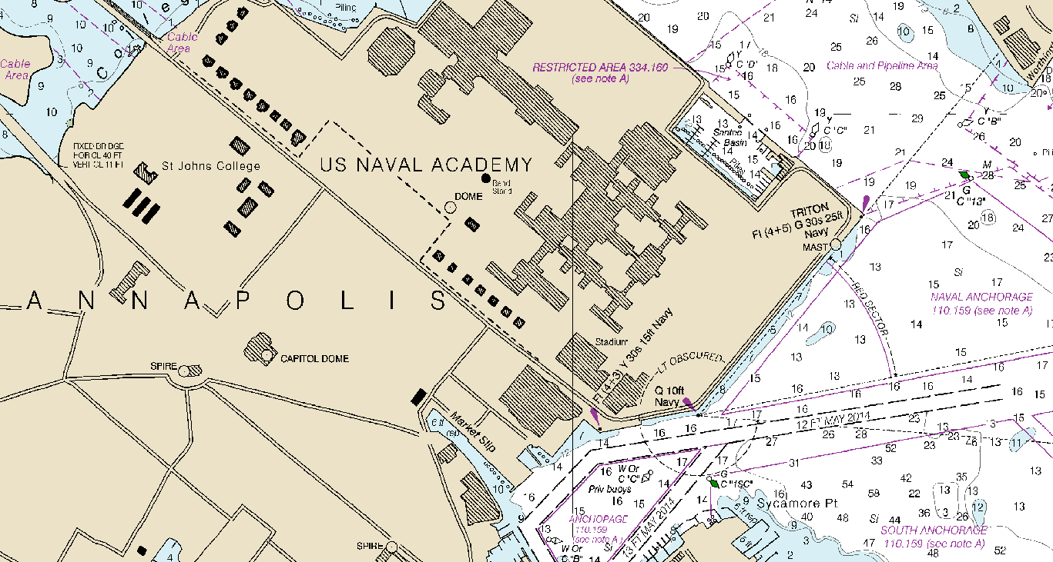
Visual NAVAIDs
Fixed object used to obatin a visual LOP (bearing);
Object must be easy to identify visualy and marked on the nautical chart;
Buoys cannot be used to obtain a LOP ((they are not fixed)); and
Examples: towers, tanks, lights, piers, daymarkers.
Effective visual NAVAID
Ineffective visual NAVAID

Slide 21
VA
50
VB

Slide 22
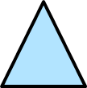
RADAR Aids
Something distinct on the radar:
A distinct shoreline
A pier
Best for navigation AHEAD/ASTERN
Shows change in range quicker
SEANAV I United States Naval Academy
NN220 – Fundamentals of Navigation
Operations Officer I HMS PROTECTOR A173 I The Ice Patrol Ship

Slide 23
Radar NAVAIDs
Fixed objects and points of coast contour (easily identified on the chart) are used to obatin a radar LOP (range); and
Matching object chosen from chart to the image on the radar is challenging;
Examples: lights, daymarkers, piers, bends on shore.
Effective radar NAVAID
Ineffective visual NAVAID

Slide 24
VA
RA
50
VC
RC
RD
VB

Slide 25
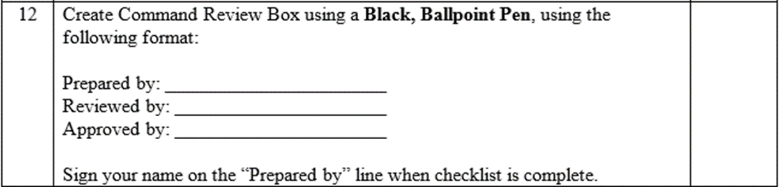
Command Review Box
All restricted water transit charts are required to have the command review block. The block provides a quick check to the Navigator that the Commanding Officer has approved the chart for navigation
SEANAV I United States Naval Academy
NN220 – Fundamentals of Navigation
Operations Officer I HMS PROTECTOR A173 I The Ice Patrol Ship

Slide 26
Enabling Objectives
FIND corrections for a given chart. APPLY corrections to a chart. IDENTIFY information that must be highlighted or outlined on a chart in accordance with the checklist. PLOT a track line using given waypoints. GENERATE track box labels. PLOT NAVAIDs using appropriate shapes and labels. GENERATE a command review box.
SEANAV I United States Naval Academy
NN220 – Fundamentals of Navigation
Operations Officer I HMS PROTECTOR A173 I The Ice Patrol Ship

Slide 27
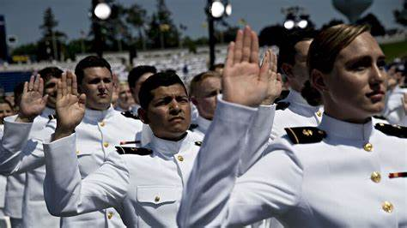
Questions?
SEANAV I United States Naval Academy
NN220 – Fundamentals of Navigation
Operations Officer I HMS PROTECTOR A173 I The Ice Patrol Ship

